Slide 1
Module 2: Independent Component Analysis (ICA) of Gene Expression Data
Part 1: Using ICA to calculate regulon structure

Slide 2



Module 2: ICA - Outline
Part 1: ICA calculation
Overview of the TRN identification problem
Independent component analysis as an effective way for top-down TRN identification
Step-by-step guide to ICA calculation
Part 2: ICA analysis
Utilizing ICA for data analysis
Choice of visualization methods
Case studies
Anand Sastry
Saugat Poudel
Kevin Rychel

Slide 3
Guide to our GitHubs
Modulome Workflow
Downloads all RNAseq data from the SRA database for an organism & QC
Runs ICA (we tend to use NERSC cloud computing; SOP coming soon)
Initial characterization steps
PyModulon [Documentation]
Stores M, A, X, and annotation data in a single sharable JSON file
Easily analyse & plot data
Make your own iModulonDB dashboards, even if characterization is incomplete

Slide 4
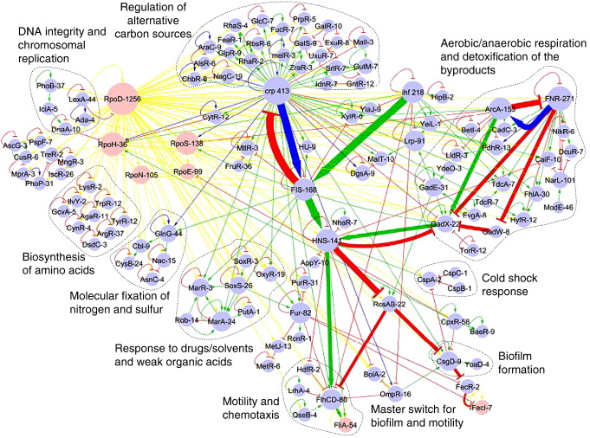
Transcriptional Regulation in E. coli
TRN consists of relationships between:
~4000 genes
~300 TFs (~150 characterized)
7 sigma factors
RNA elements
No nucleus, introns, histones, etc.
Martinez-Antonio et al. JMB. 2008

Slide 5
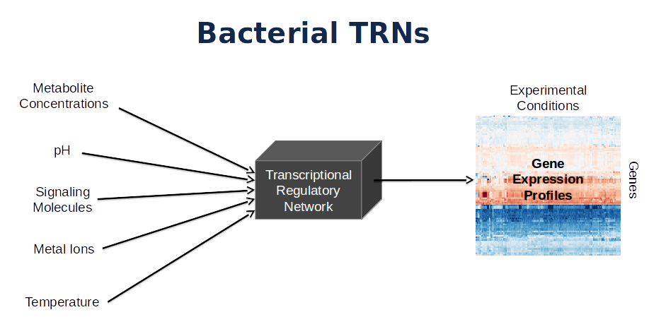
Inferring the structure and activity of the TRN
The activity of the TRN is a result of a combination of sensed signals from the environment
Can we understand which signals the cell is receiving under a given condition?
?

Slide 6
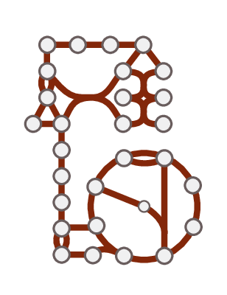
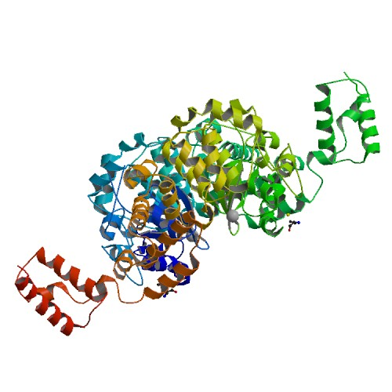
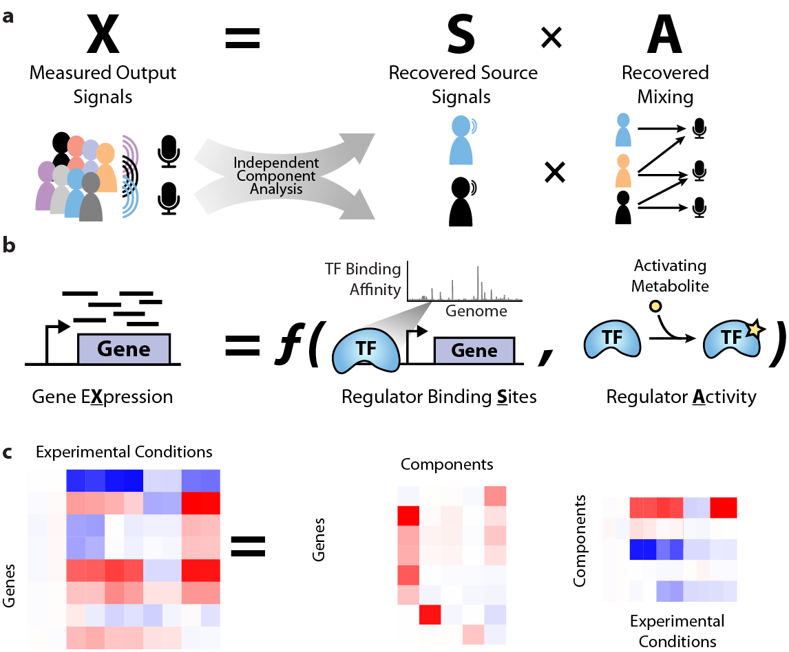
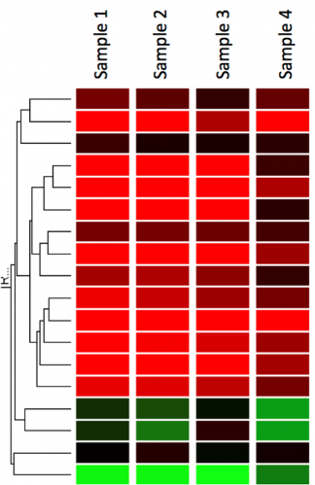
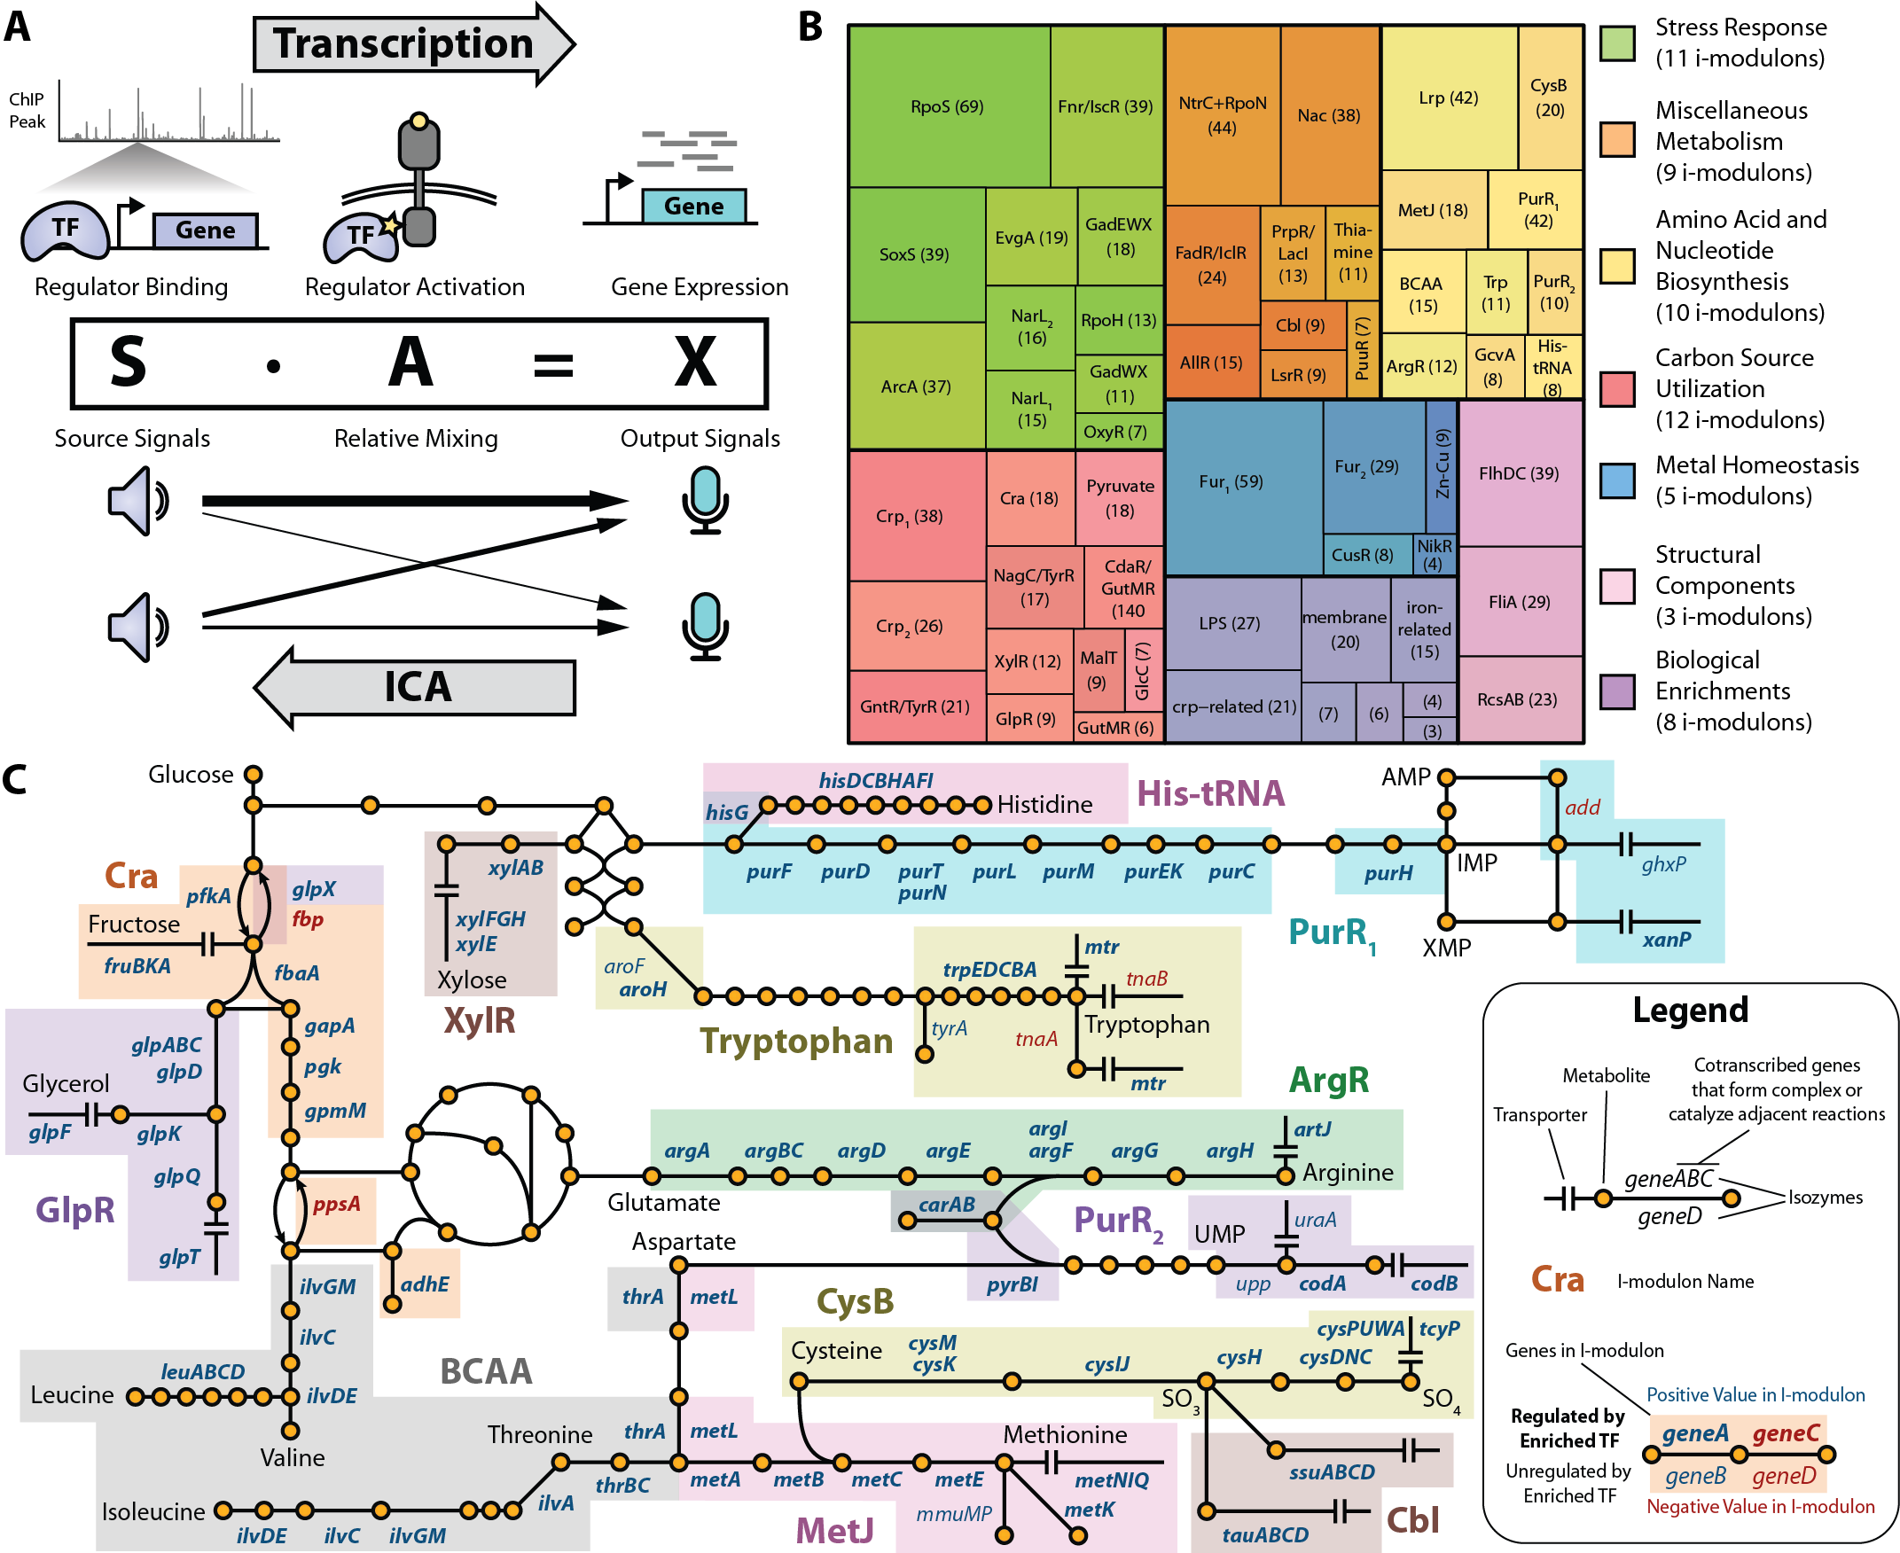
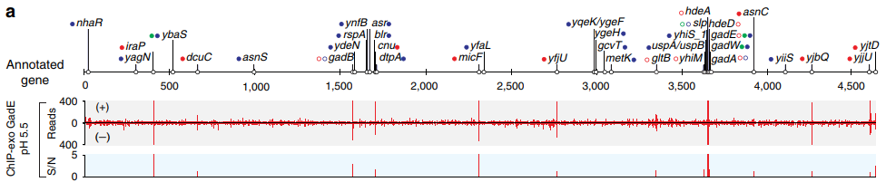
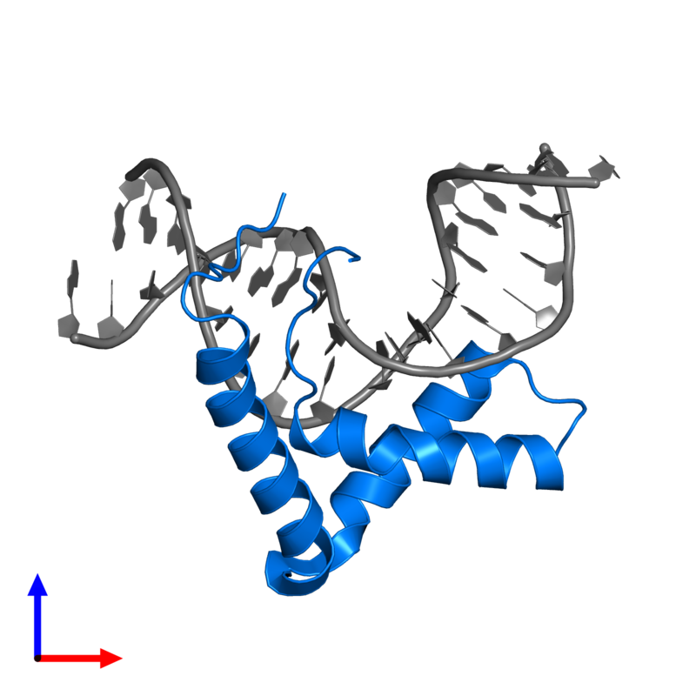
Systems Approach to Gene Regulation
f (
) =
Seo et al. Nat. Comm. 2015

Slide 7
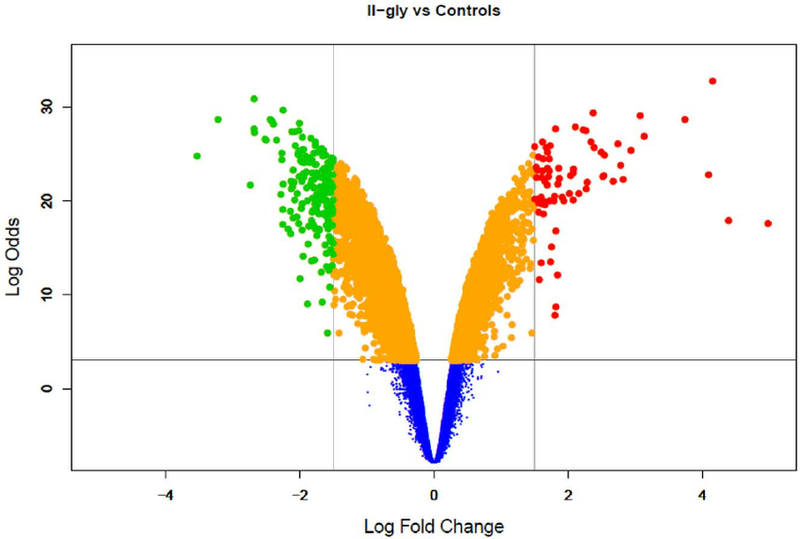
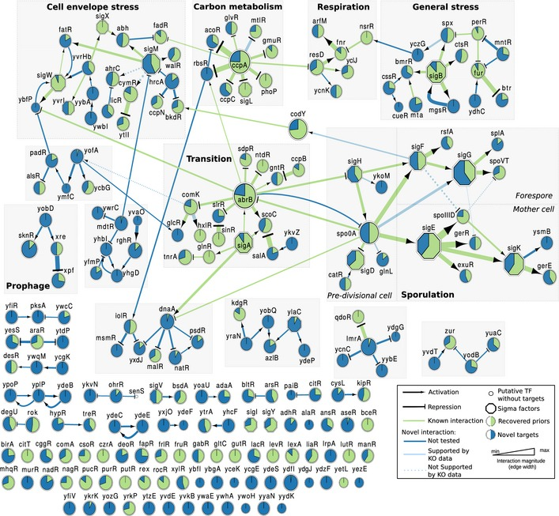
RNAseq Analysis Methods
Traditional: Differentially expressed genes (DEGs)
Statistical comparison for each gene
Result = thousands of p-values; no inherent structure
Network-based models (e.g. NCA)
Encode the known TRN and learn parameters
Requires a priori knowledge, and biases towards it
Unsupervised machine learning
Clustering
Visualization methods: tSNE, UMAP
Matrix decomposition
Best method = ICA [source]

Slide 8
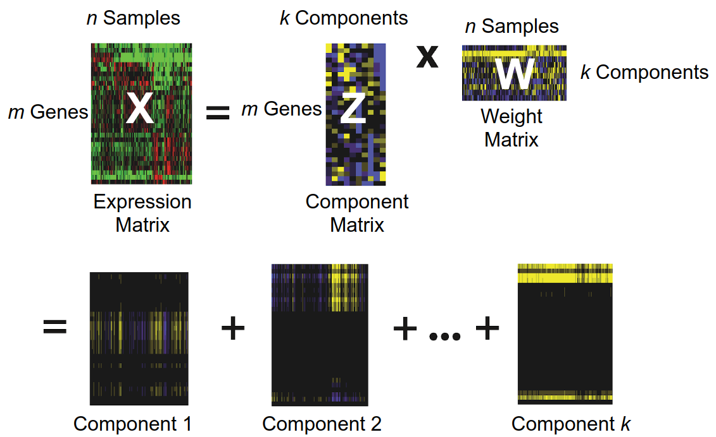
Matrix Decomposition: Basics
X
=
M
✖
A
Adapted from Teschendorff et al. PLoS Comp Biol. (2007)
Create 2 matrices which multiply back to the original
Many solutions; need to specify constraints & objectives
PCA: Maximize explained variance by using uncorrelated components
ICA: Maximize statistical independence of components
NMF: Represent data using only are non-negative components

Slide 9
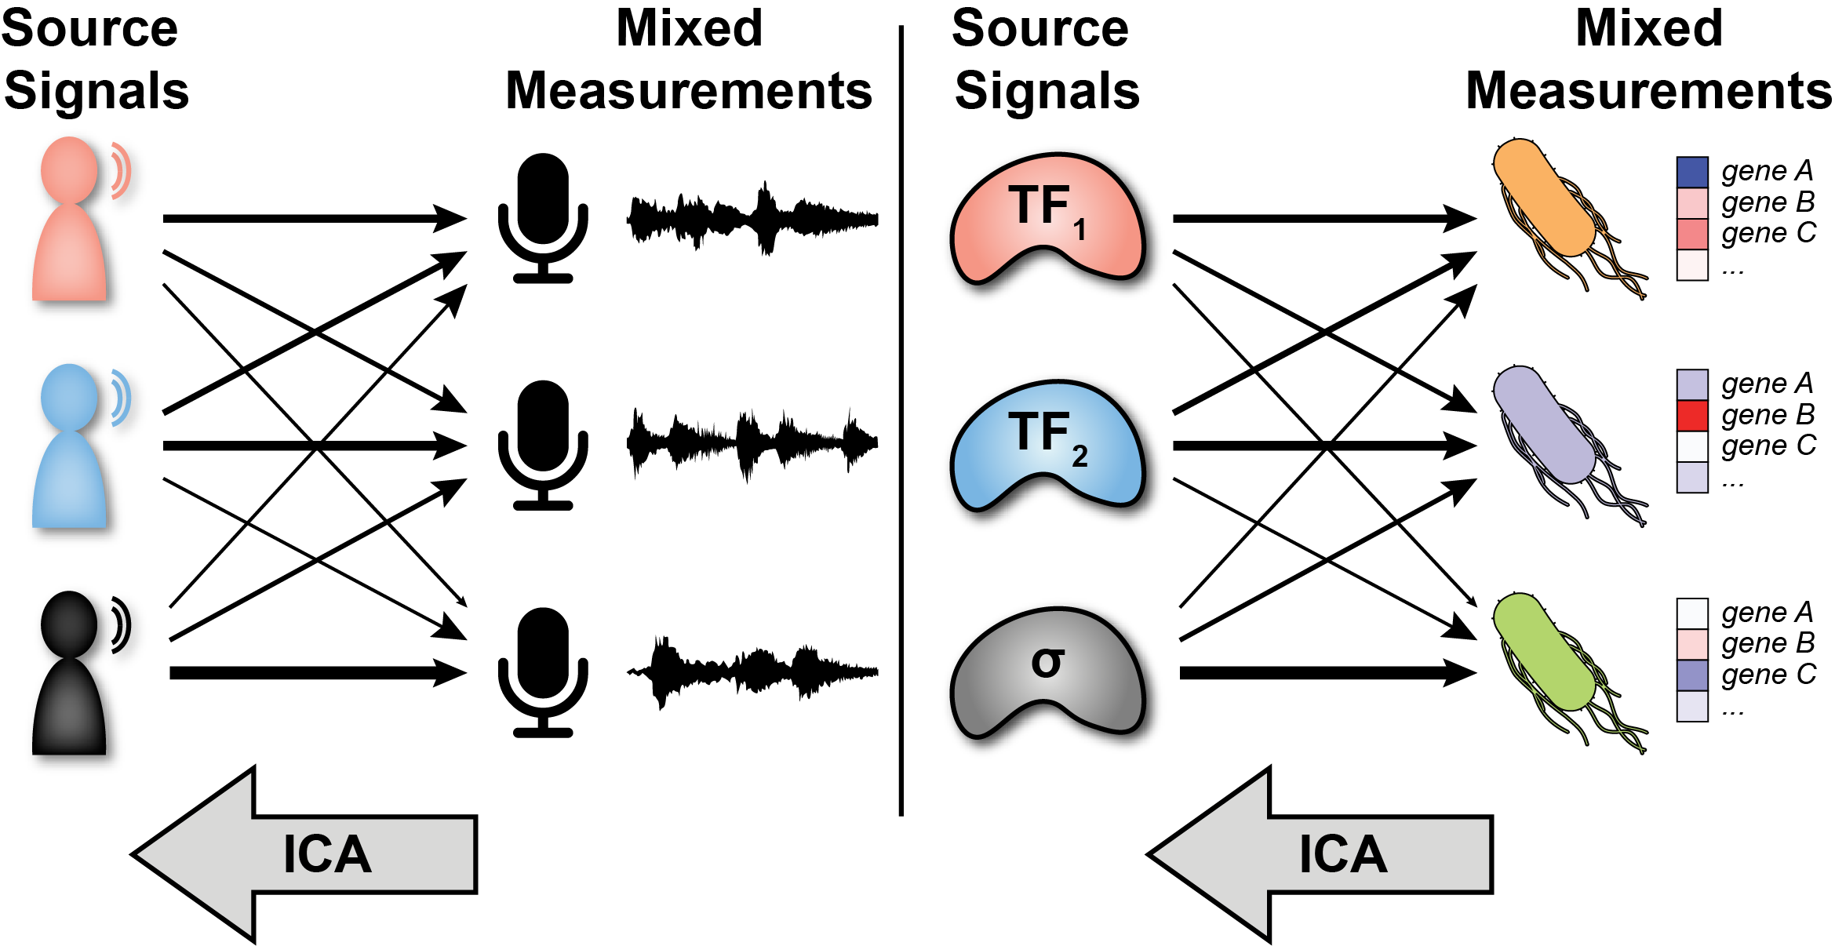





Independent Component Analysis (ICA)

Slide 10
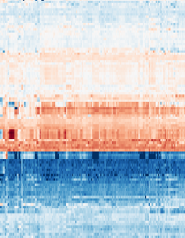
Mathematical Representation
Experimental
Conditions
Signals
Experimental
Conditions
S
A
X
Genes
Genes
Signals
EXpression Profiles
Regulator
Signals
Regulator Activities

Slide 11
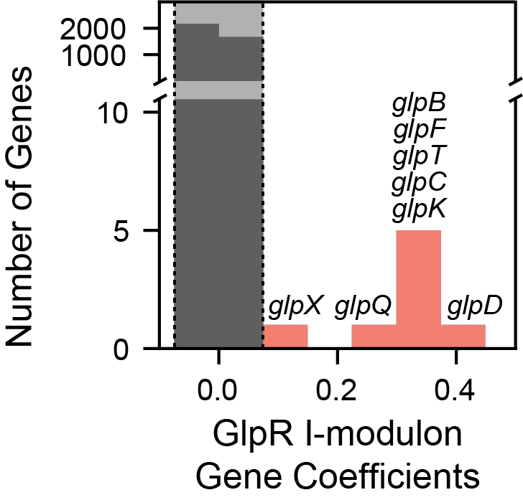
Mathematical Representation
Experimental
Conditions
Signals
Experimental
Conditions
S
A
X
Genes
Genes
Signals
EXpression Profiles
Regulator
Signals
Regulator Activities

Slide 12
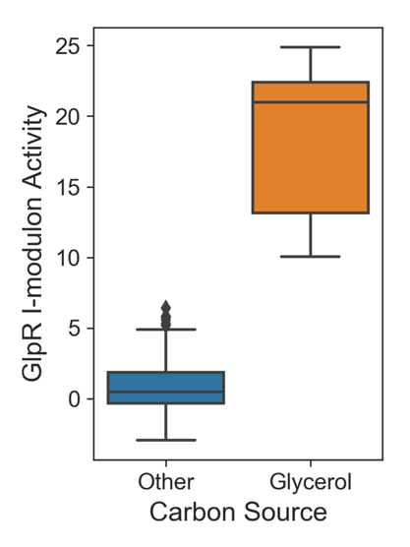
Mathematical Representation
Experimental
Conditions
Signals
Experimental
Conditions
S
A
X
Genes
Genes
Signals
EXpression Profiles
Regulator
Signals
Regulator Activities

Slide 13
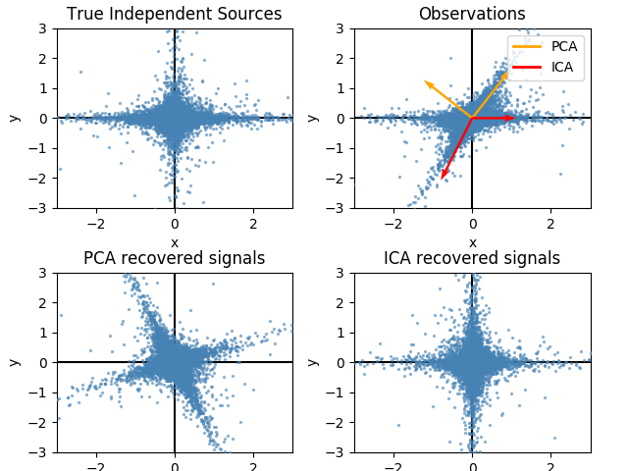
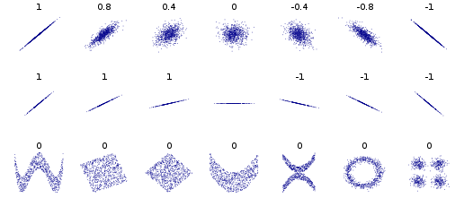
ICA vs PCA
PCA identifies orthogonal directions of maximal variance
ICA identifies statistically independent patterns
Independence == No linear OR nonlinear trend
Dependent
Independent
Correlated
Uncorrelated
Notes:
What separates ICA from PCA? As we just showed, PCA identifies uncorrelated (i.e. orthogonal) directions of maximal variance. However, ICA identifies statistically independent patterns in the data. Independence means that knowledge of one variable does not give any information about the other variable. In the table below, we see that a correlated point cloud has a nice linear trend. If we know a value of x, we can predict the value of y with some error. However, an uncorrelated dependent data cloud has no linear trend, as shown by the U-shaped cloud. However, there is a shape to the cloud that could be fit by a non-linear function. For two variables to be independent, they must be uncorrelated, as shown by the bottom-right cloud. If you imagine making vertical slices of this data-cloud, the probability distribution across every slice would be constant. Therefore, knowledge of x does not give any information about y. By definition, you cannot have a correlated and independent dataset.
On the right, we show two independent variables. If we mix these variables together using some mixing matrix, we contort the point cloud into the top-right observation cloud. Applying PCA to this observation cloud results in the first component pointing in the direction of maximal variance, and the second component being orthogonal to the first. However, ICA identifies non-orthogonal directions such that the projections of the genes onto the directions are independent. One way to visualize the projections is to take each point, and move it perpendicularly to the each axis to get the loading on each component. When we do this for the PCA axes, we recover the point cloud to the bottom-left. However the ICA projections almost exactly reproduce the original sources. Note that the PCA projection looks like a rotated version of the ICA projection.
[This is an important slide -- not terribly clear -- maybe break into two slides -- I may try suggest how]

Slide 14
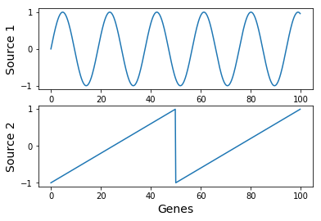
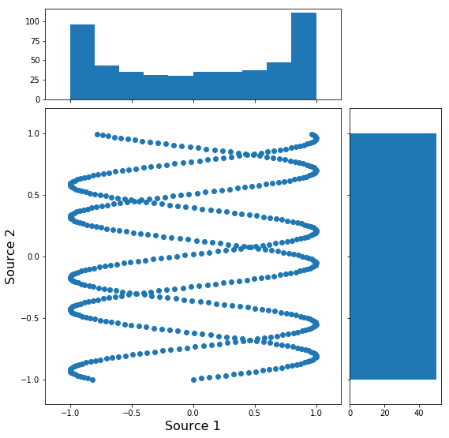
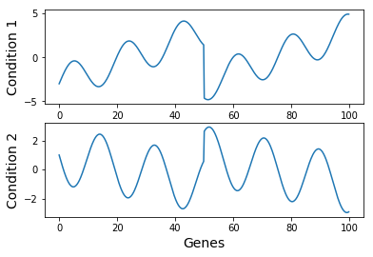
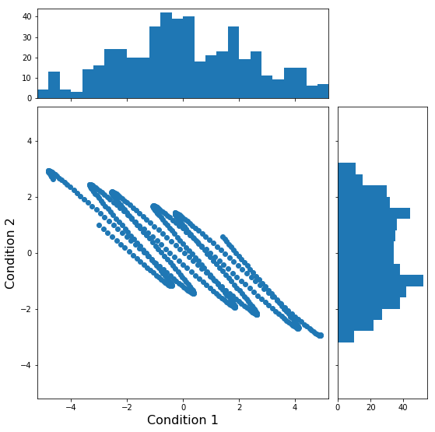
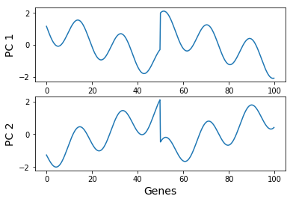
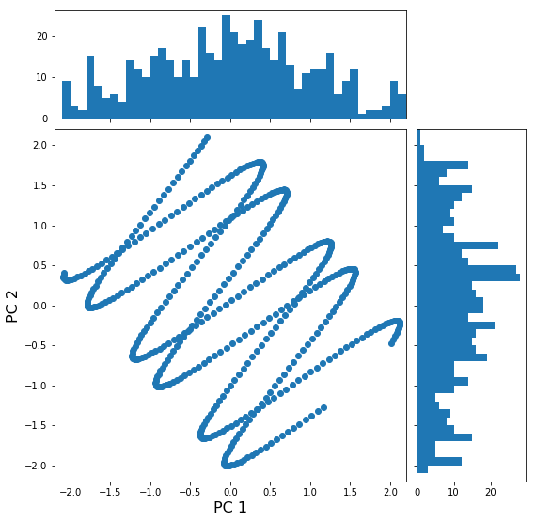
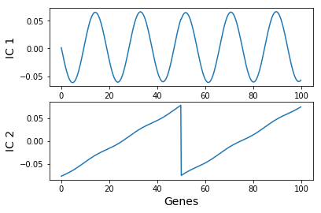
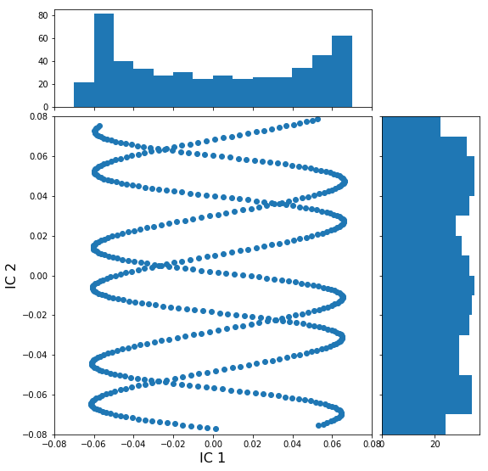
The FastICA Algorithm
Center data (mean = 0)
Whiten data
Remove correlations using SVD
Original Sources
Rotate whitened data to minimize Gaussianity
Sum of random variables tends towards normal distribution
Mixed
Signals
Whitened
Data
Separated Signals
Notes:
ICA requires a bit more math than PCA, so we will review the algorithm in broad strokes. There are multiple algorithms to perform ICA, and the FastICA algorithm is one that performs well. On the right, we see the original sources, and then the mixed sources. The scatter plot of the two sources is shown next to the signals, with the distribution shown on each axis. Notice that the mixed signals look much more like a gaussian distribution than the original signals. This is due to the central limit theory of statistics, which states that the summation of two random variables is more gaussian than either of the two original variables. This theory underlies the intuition behind the algorithm.
The first step of the algorithm is to center the data, such that the mean of each sample is 0. We then whiten the data, which means that we remove all correlations. We can do this using SVD. After applying SVD (plus an additional step), we achieve our whitened data. If you examine the scatterplot to the right, you will see that the variance in any direction is 1. This is why whitening is also commonly called sphering.
The whitened scatterplot looks very similar to the original data, but just rotated. The FastICA algorithm rotates the data until the projections on each axis look as non-gaussian as possible. Once this is achieved, the algorithm stops, and we see that we have found the original sources.

Slide 15
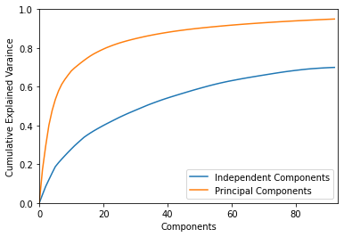
Explained Variance
Reconstruct X using M*A, compare reconstructed with original
Usually get 65 - 80%
Can also use smaller M, A with less iModulons (or even just 1)
Tells how mathematically important each iModulon is
Uses:
Quantify iModulon dataset as a whole
Sort iModulons on iModulonDB

Slide 16
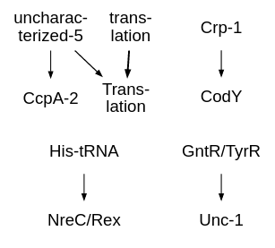
Adding New Data
Adding new data & running ICA
Requires computation to re-run
New M matrix will be more accurate
Includes new signals activated by new conditions
May break old iModulons up into two
Can correlate M matrices easily
Alternatively, infer activities using matrix multiplication
Computationally easy
No new signals, but easily compare iM activities
X’: new data
A’: new activities
M: previously computed M
X’ = M*A’
M⁻¹*X’ = M⁻¹*M*A’
M⁻¹*X’ = A’

Slide 17
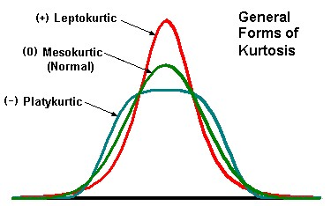
Measuring Non-Gaussianity
Kurtosis: Sharpness of peak
Gaussian distribution has kurtosis of 0
Kurtosis = 0 does not imply gaussian
Not a robust measure of non-gaussianity
Negentropy (J):
Gaussian distribution has maximum entropy (H)
J(X) = H_{gauss} - H(X)
Negentropy is difficult to calculate
Need Contrast Function
Approximation of negentropy
Simple to calculate

Slide 18
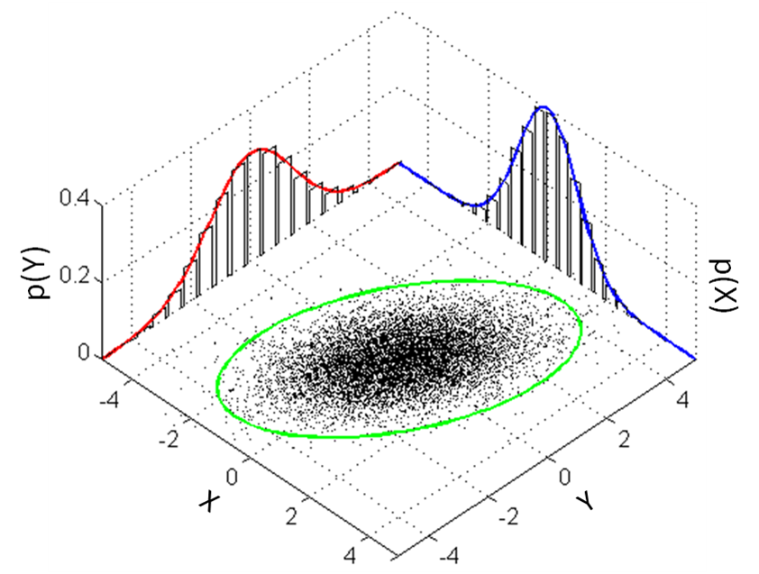
Limitations to ICA
ICA cannot discriminate between two Gaussian sources
Experimental noise may interfere
Requires high-quality data
ICA is a stochastic algorithm that may not find the global optimum
Must run 20-100 times and keep only consistent components
ICA does not provide an intrinsic order to components
May order by |A²|
ICA does not reduce dimensionality
Can preprocess with PCA/SVD
Notes:
Although ICA can detect more relevant signals than PCA, it has more limitations. First, ICA cannot discriminate between two gaussian sources. Therefore, if you have multiple sources of gaussian noise in your dataset, ICA will not be able to separate the two. This can be visualized by projecting the data to the left in any direction. No matter where you point, the projection will always look gaussian, limiting the ability of FastICA to find non-gaussian sources. This causes ICA to require high-quality data.
The second limitation is that ICA is a stochastic algorithm that may not find a global optimum. Therefore, you must run ICA 20-100 times and only keep components that consistantly arise.
Unlike PCA, ICA does not provide an intrinsic order to components. This is because most components in ICA have biologically relevant meanings. However, you may order your components by the norm of the mixing matrix, in order to see which components have the largest effects on your dataset.
Finally, ICA does not reduce dimensionality. If you would like to remove noise first, you can run PCA or SVD and remove some components before running ICA. This tends to help alleviate limitation #1.

Slide 19
ICA Parameters
Run ≥100 times:
sklearn.decomposition.FastICA(
n_components=None,
algorithm=’parallel’,
whiten=True,
fun=’logcosh’,
max_iter=200,
tol=0.0001,
w_init=None,
random_state=None)
# components to reconstruct 99% of variance through PCA
10^10 (Nearly infinite)
10⁻⁷ (trade-off between computation time and sensitivity)

Slide 20
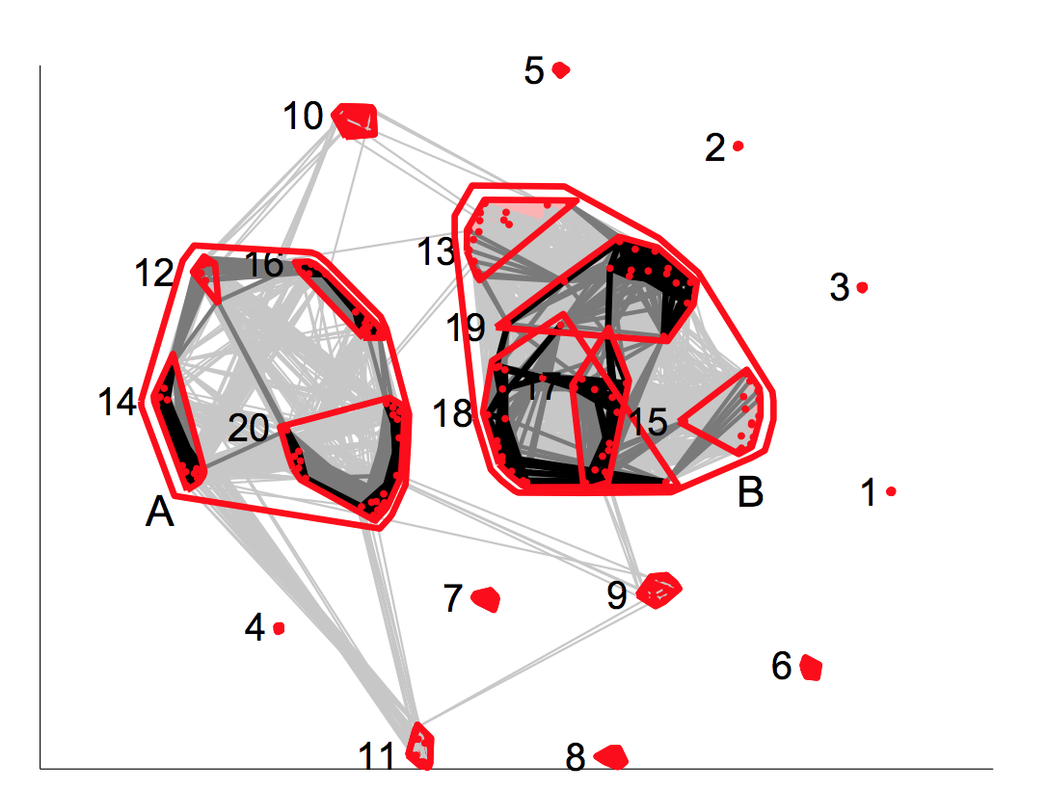
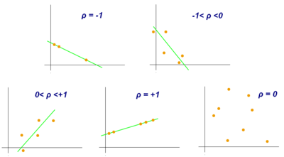
Identifying Robust Components
Run FastICA(X) ~100 times
Find distance between components
D = 1-|R|
Cluster components
Centroid of cluster is true component
Metric Multidimensional Scaling (MMDS)

Slide 21
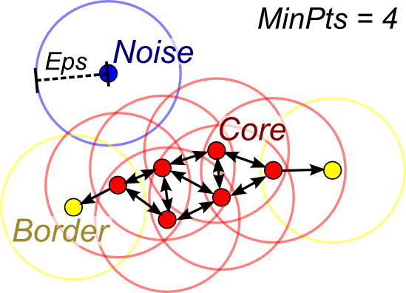
Clustering Requirements
One cluster per observation
Unknown number of clusters
Allow unclustered points
Minimum cluster size
DBSCAN

Slide 22
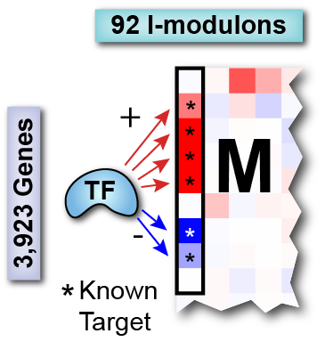
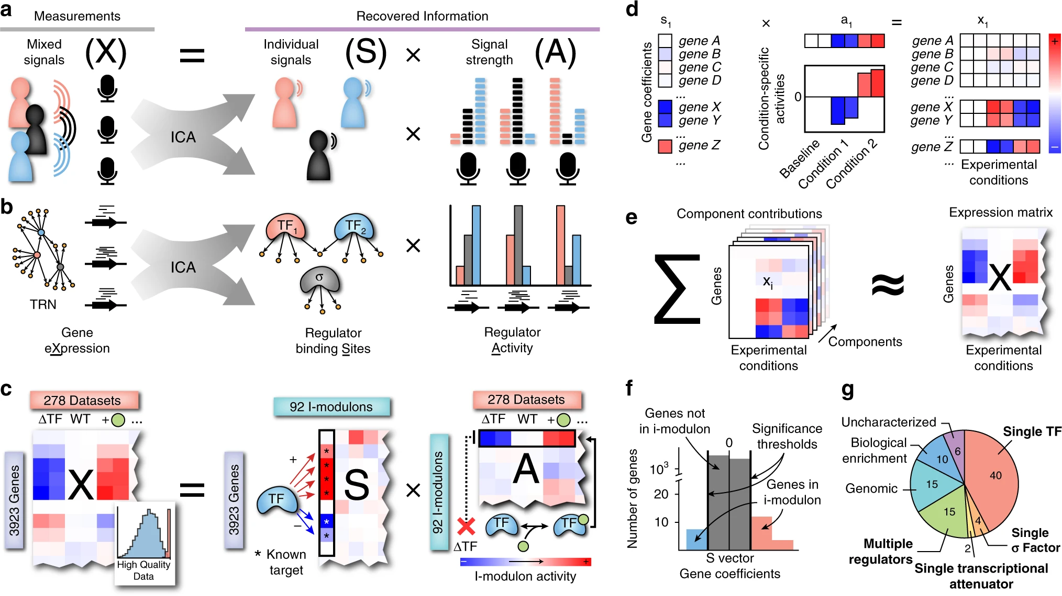
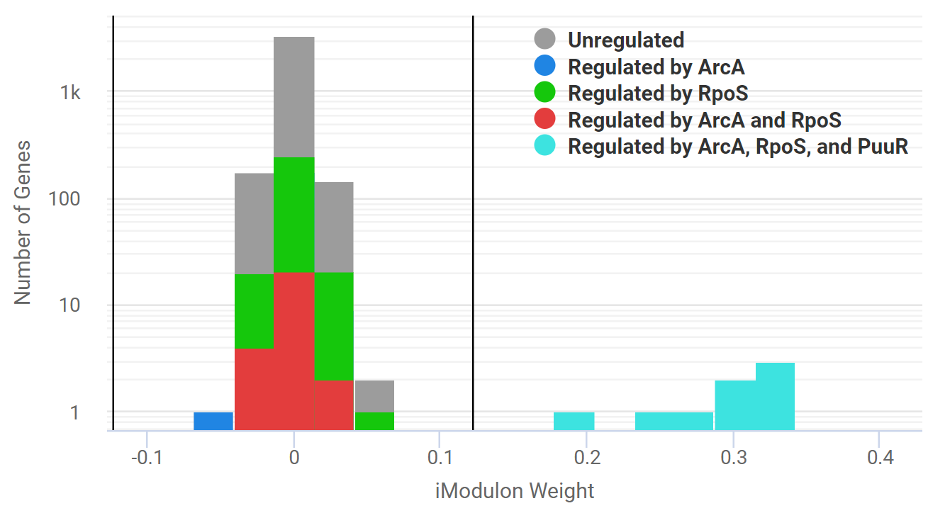
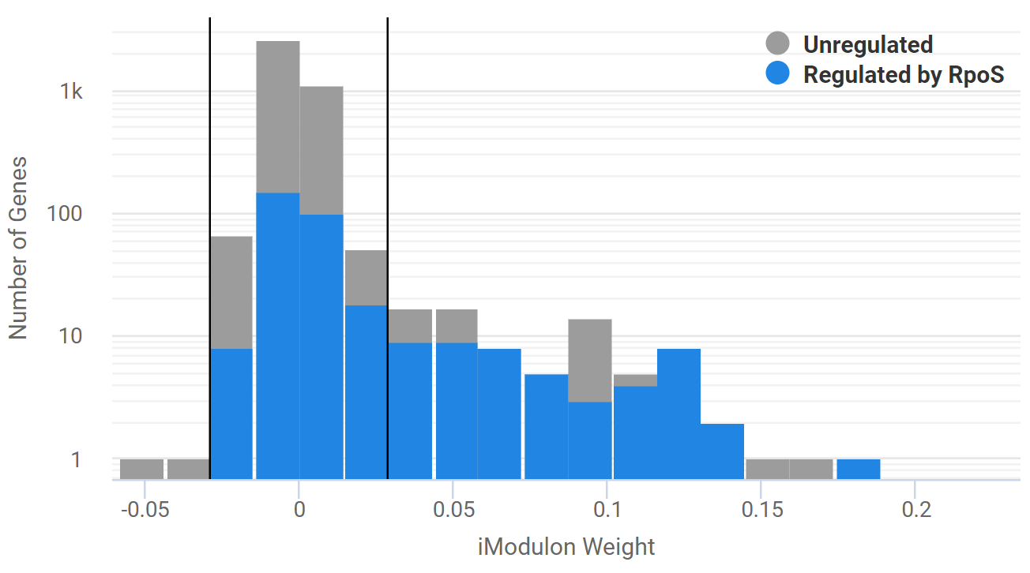
M Matrix Analysis:
Gene Thresholding
Decimal values → Yes/No values
Difficult to draw the line, though
Negatively weighted genes are anti-correlated
Two methods:
D’agostino: remove highly weighted genes until what remains is normally distributed
Requires a cutoff
Can optimize if a TRN is provided; goal is to align membership with known regulons
K-means: take absolute value, make two clusters
Non-parametric, does not require the TRN
Performs slightly worse

Slide 23
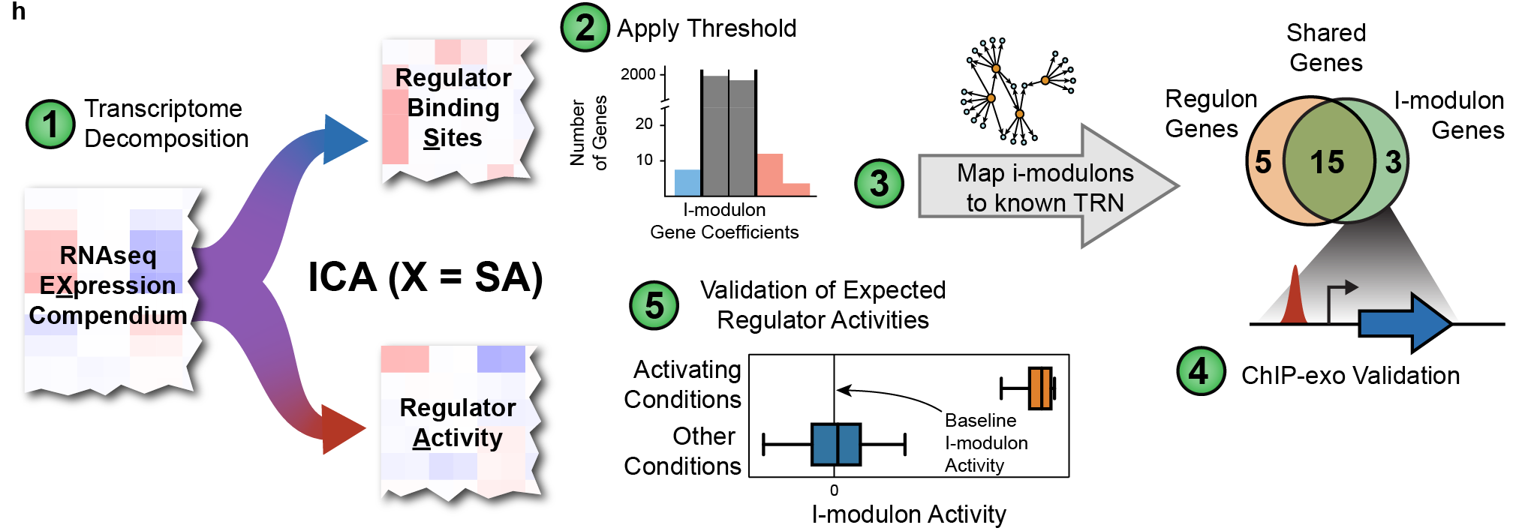
Summary: ICA workflow

Slide 24
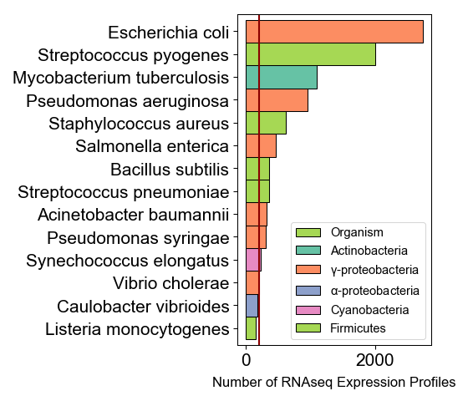
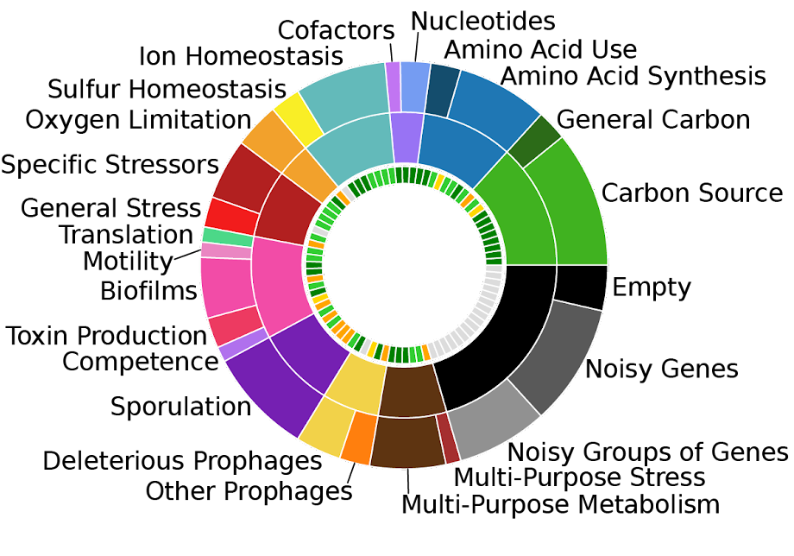
Applications to bacteria
Publicly available RNA-seq data on NCBI GEO
ICA of B. subtilis Microarray Dataset

Slide 25
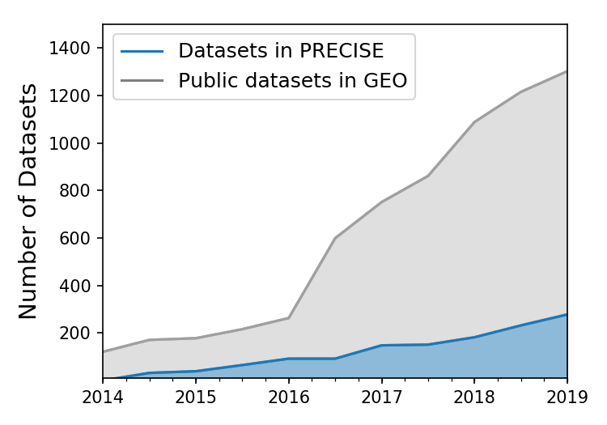
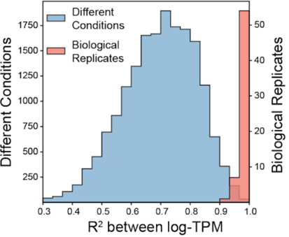
The need for high-quality data:
PRECISE - A High Quality Expression Compendium
Growth of E. coli RNA-seq datasets
RNA-seq data spanning over 6 years
Currently nearing 1000 Datasets (significant fraction of NCBI GEO)
High quality, self-consistent data (Median R² = 0.98)
Notes:
generated in the same lab with the same protocol
This consistency allows us to compare transcriptomics data across experiments spanning...

Slide 26
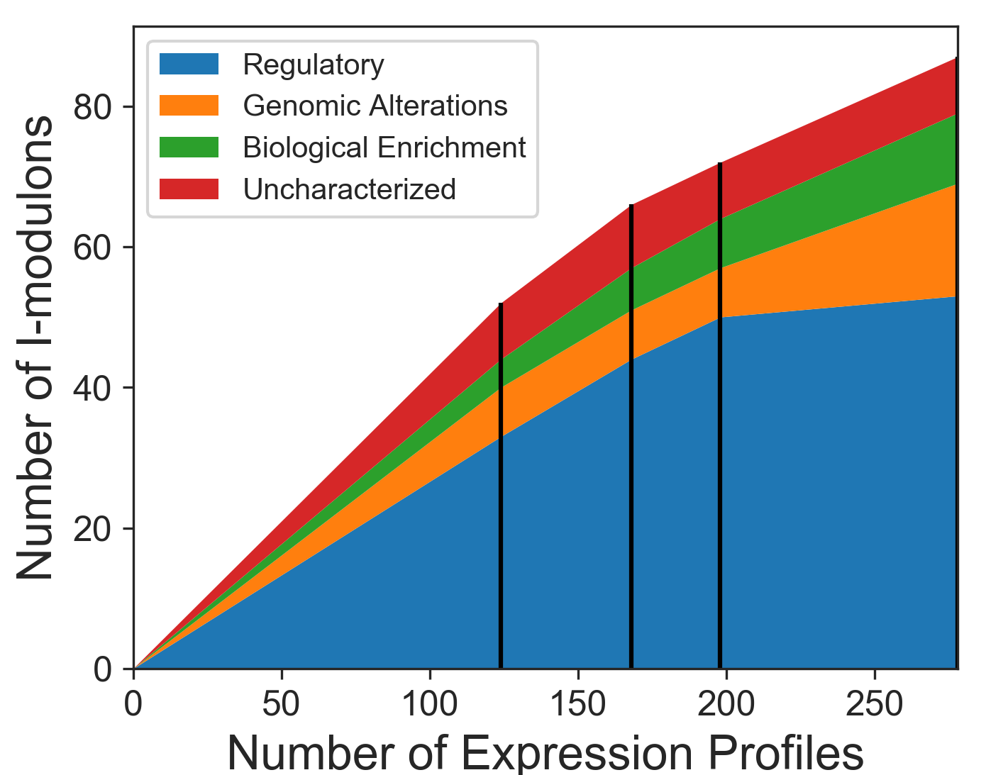
How does dataset size affect i-modulons?
124 Datasets
(12 Studies)
+42
(+4)
+30
(+1)
+80
(+4)
X₁
X₂
X₃
X₄
4,000 genes
Diminishing returns
More ALE Endpoints = More Genomic i-modulons
Number of uncharacterized i-modulons is constant
Notes:
S/N ratio increases

Slide 27
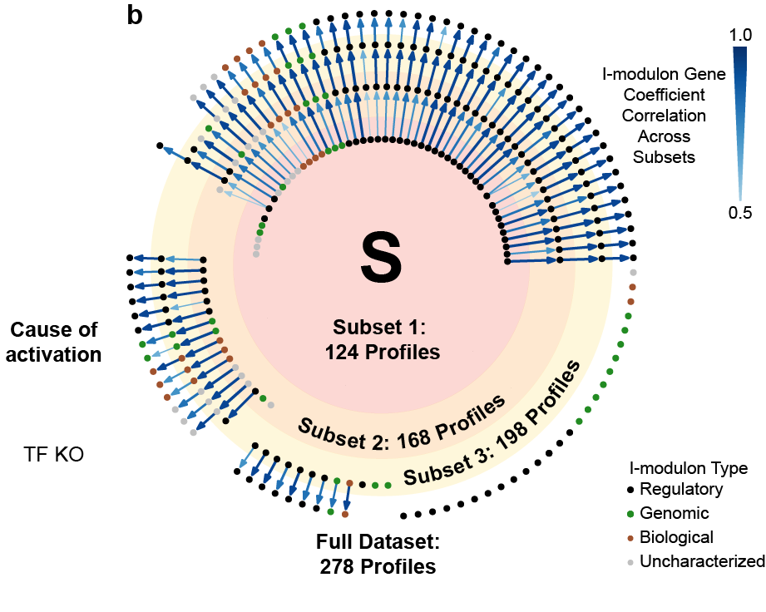
I-modulons are robust to new data
Notes:
We can use this older data to further contextualize new data.
Another amenable characteristic of i-modulons is that they are very robust to new data. As our lab continues to generate more expression datasets, the addition of these datasets does not seem to significantly perturb the previously computed structure. In this graph, each circle represents a subset of our data. Each node is an i-modulon, and the arrows show how well these i-modulons are conserved. In general, regulatory i-modulons are highly conserved, whereas uncharacterized i-modulons tend to get lost, indicating they may just represent noise in the dataset.

Slide 28
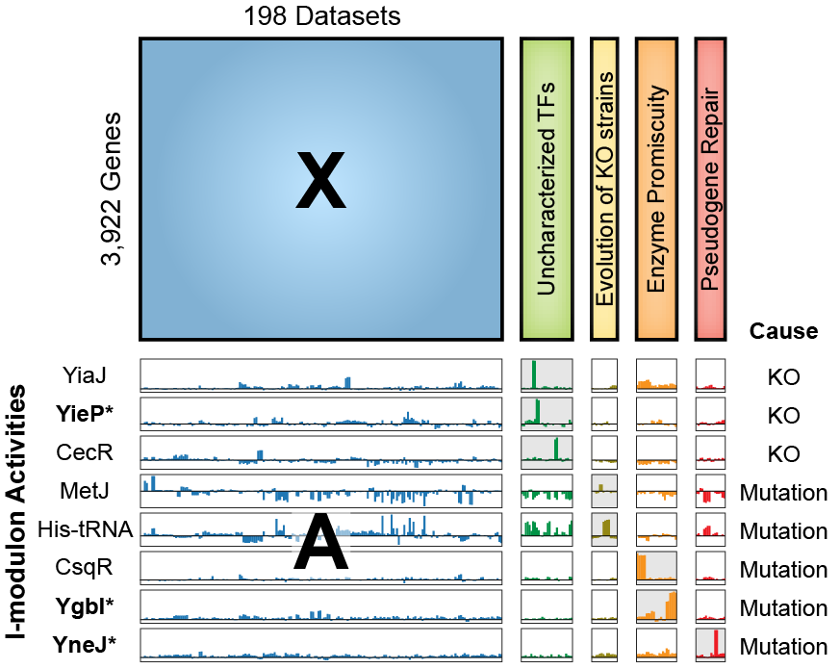
What can we learn from new data?
ALE
4 studies published in 2018 with RNAseq
Genetic changes reflected in i-modulon activities
i-modulons are smaller than DEGs
Three poorly characterized TFs (YiaJ, CecR, CsqR)
Three uncharacterized TFs (YieP, YgbI, YneJ)
Nat Comms. 10: 5536 (2019). (2019)

Slide 29
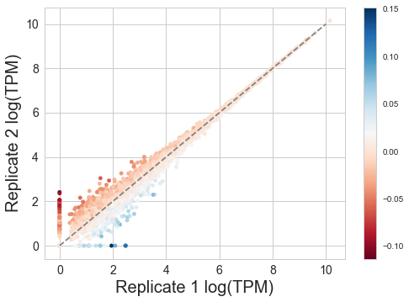
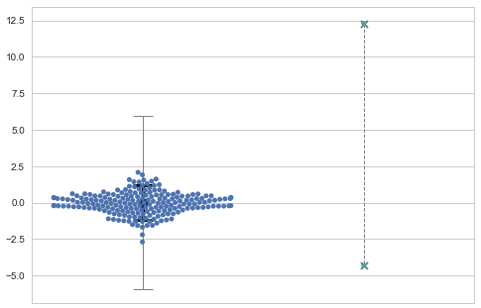
How does low quality data affect results?
Outcome 1: Data creates its own I-modulon
I-modulon Activity
R² = 0.94
All other experiments
Experiment
replicates

Slide 30
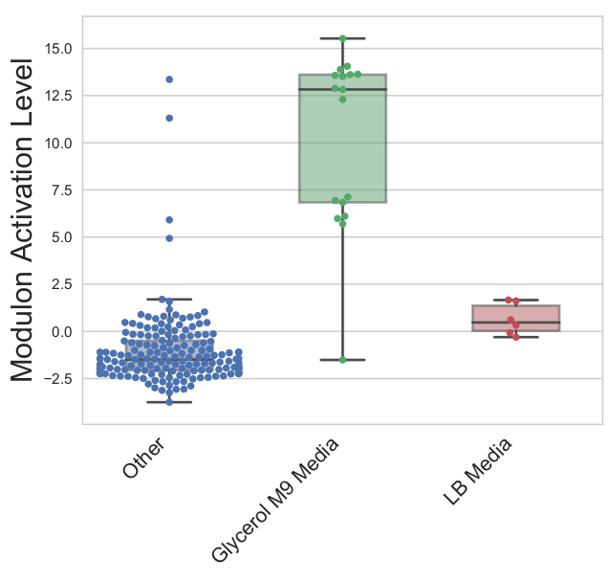
How does low quality data affect results?
Outcome 2: Inconsistent mapping
Gly ALE2

Slide 31
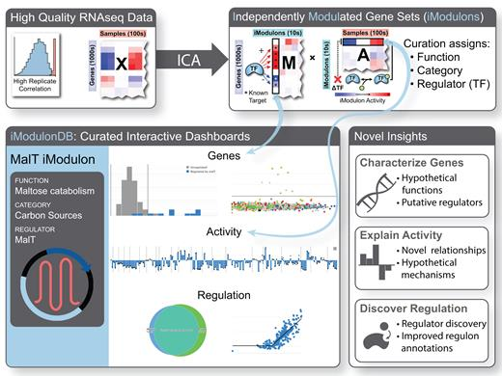
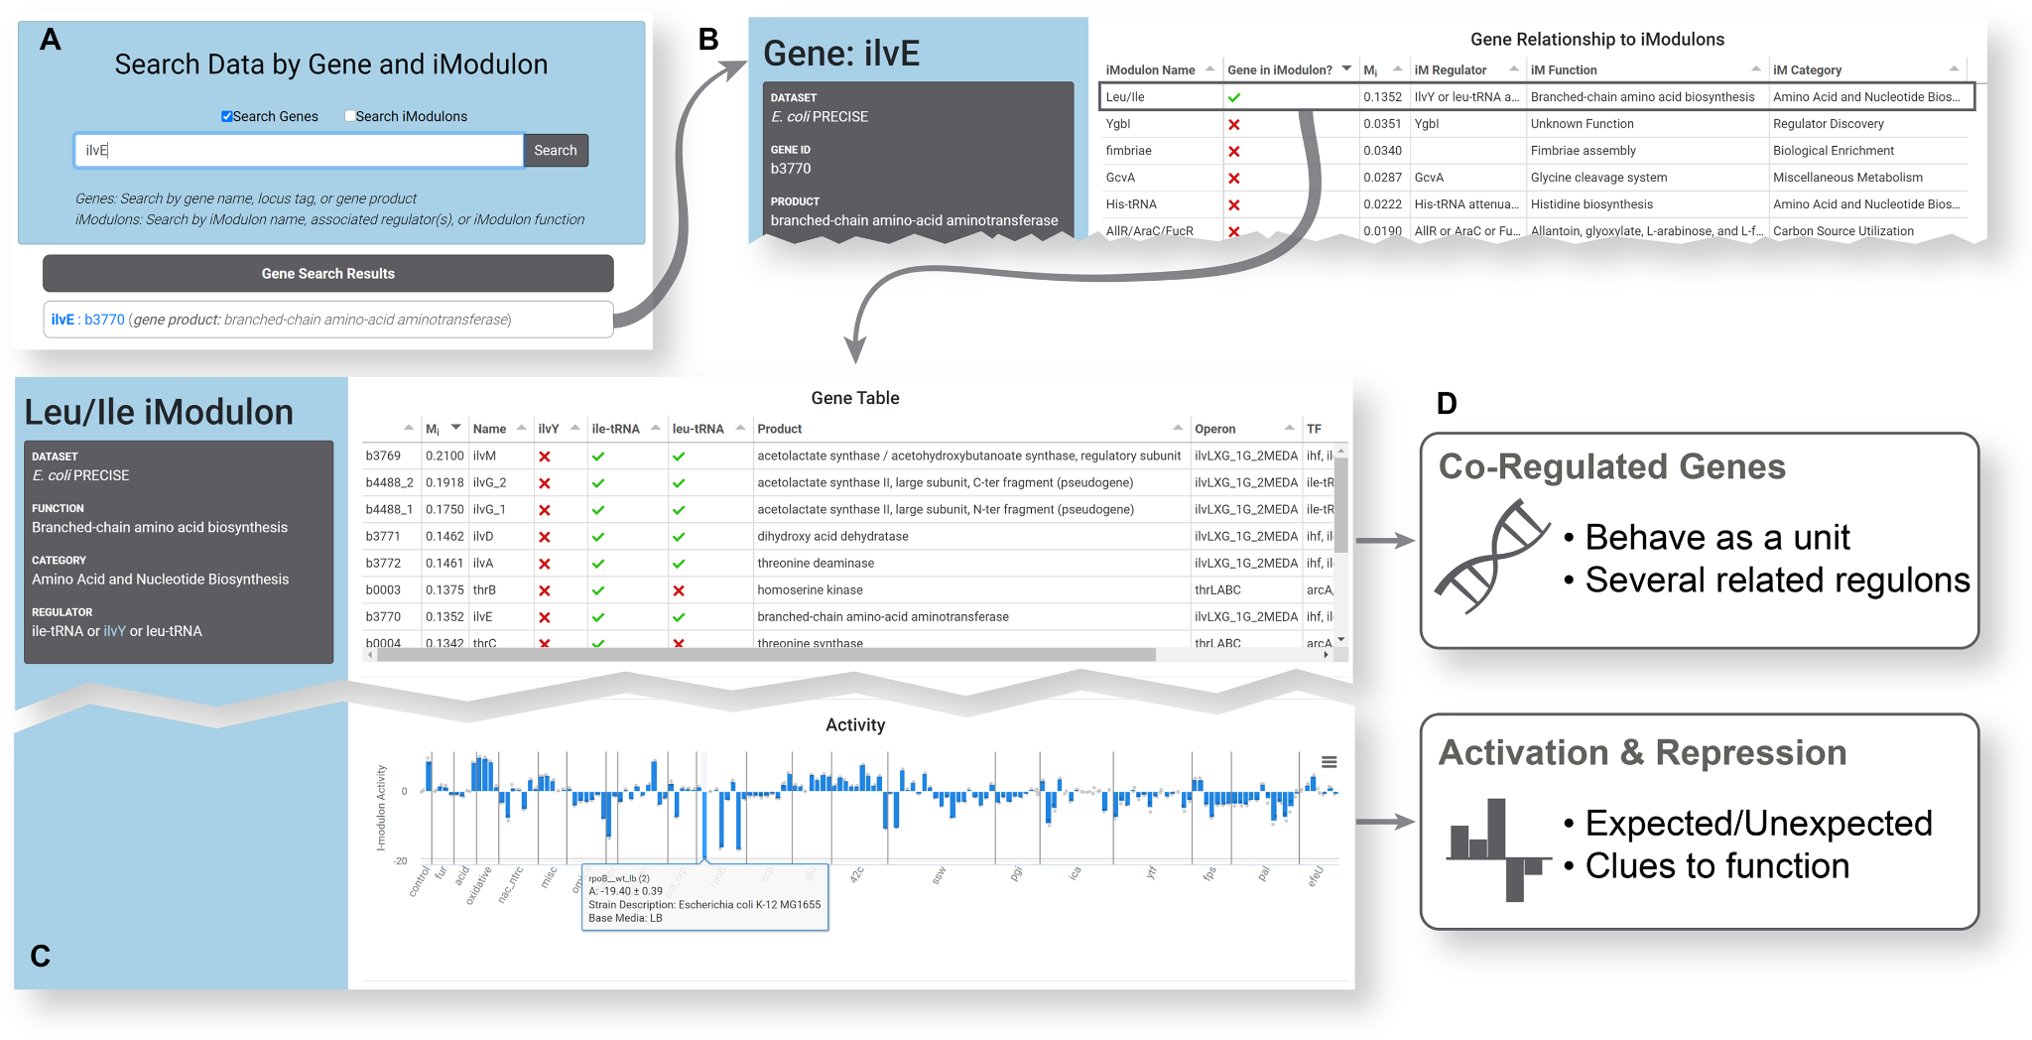
Using iModulonDB

Slide 32
Module 2: Independent Component Analysis (ICA) of Gene Expression Data
Part 2: Analyzing gene expression regulation with ICA

Slide 33




What is an i-modulon?
Source: condition-
independent
Activity: condition-
dependent
Nat Comms. 10: 5536 (2019). (2019)
Notes:
So how do the S and A matrix work together to recreate the expression matrix? I’ll illustrate this through the Cra I-modulon. Here, you see a representation of glycolysis, with glucose on top and the TCA cycle below. Cra is the major regulator of glycolysis, and it is activated by fructose-1-phospmodulhate.
An i-modulon is defined as a group of independently modulated genes. To make things simple, we designate a baseline condition (WT glucose M9 minimal media), so we can interpret the condition-specific activities.

Slide 34

The S Matrix
71 Independent
Components
S
4000 Genes
Values are coefficients of genes at ICs
Most coefficients near 0
Centered and L2 norm of 1
No canonical direction
Columns are statistically independent

Slide 35


S Matrix Analysis: Enrichment
Regulons: Bottom-up gene groupings
Defined by decades of literature research
TF Binding sites, KO & overexpression
Found in “TRN” files
iModulons: Top-down gene groupings
Observed in transcriptome
Quantify overlap between the two for any iModulon & regulon
Can also use “or” and “and” relationships
iModulons are usually named after their enriched regulons
iModulon Recall
iModulon Recall
Regulon Recall
Regulon Recall

Slide 36

Metabolic i-modulons:
Shown on a network map
Nat Comms. 10: 5536 (2019). (2019)

Slide 37




The Cra I-modulon
S
A
X = S ∙ A

Slide 38

Validation of Regulator Activities

Slide 39


Other Types of iModulons
iModulons capture all independent signals, not just transcription factors
Genomic alterations (gene KOs, strain differences)
Biological/functional (no known regulator)
Uncharacterized (possible noise)
pdhR Knock-Out iModulon

Slide 40


The Initial 94 I-modulons

Slide 41

Types of I-modulons

Slide 42

Types of I-modulons

Slide 43

The A matrix
~250 Samples
Values are activities of ICs
WT glucose M9 media = 0
Variance can change
Not independent, or even decorrelated
A
71 Independent
Components

Slide 44


Properties of I-modulons
Notes:
So given this structure, some interesting properties emerge from the dataset. For example, some the expression level of some regulators are highly correlated with their activity levels. However, many regulator activities are not correlated with their expression levels, indicating a different driver of regulator activity, such as phosphorylation. In other cases, a minimum expression level is required for regulator expression.
We can also compare i-modulon activities to physiological characteristics. For example, we see that the translation i-modulon activity, which consists of mostly ribosomal subunit genes, is correlated with the measured growth rate.

Slide 45

A Matrix Analysis: Activating Conditions
Going through the conditions that change an iModulon’s activity gives many insights
Examples (B. subtilis):
FadR: fatty acid utilization
Increases when Bacillus is starved of glucose (as expected)
LexA: DNA damage
Increases when DNA is damaged (as expected)
Also may lead to swarming (surprising)
Evidence of this found in a later study

Slide 46

A Matrix Analysis: DiMAs
Differential iModulon Activities
Compare two conditions, highlight significant iModulon changes
Much simpler than comparing thousands of genes
Below: tuberculosis activates virulence (DevR) when oxygen is gone, cell wall synthesis when it comes back

Slide 47


I-modulons can detect more than DEGs
Traditional analysis only identifies 13 DEGs
Genes in RpoS I-modulon

Slide 48


Correlations in A reflect fundamental biology
Catabolite repression (CRP), Respiration (ArcA and FNR), Iron metabolism (FUR)

Slide 49


iModulon Clusters
Stimulon: genes that respond to a stimulus, which may combine regulons
Real TRNs have a hierarchical structure
Hierarchically cluster iModulon activities
Obtain groups of iMs frequently co-expressed
Further dimension reduction
Identify TRN hierarchies

Slide 50
More case studies

Slide 51

Measuring Cellular Stress:
through rpoS i-modulon activity level
Nat Comms. 10: 5536 (2019). (2019)
Notes:
Strains evolved for the fastest growth rate on laboratory media tended to acquire mutations in RNA polymerase, which significantly reduce the expression of stress-related proteins

Slide 52

The Fear vs. Greed Trade-off:
Inverse correlation between i-modulons
Cell Syst 27:260-271 (2016)
Notes:
When we plot the RpoS i-modulon activities against another i-modulon enriched in translational machinery, we see a clear trade-off between growth and stress. We also see that strains with specific mutations knocked-in to RNA polymerase shift along this trend line, increasing translational activity and reducing the expression of stress functions.
This is a global response that you cannot detect using methods such as differential gene expression.

Slide 53


OxyR Mutations
Senses peroxide
OxyR Mutants
Mol Biol Evol. doi: 10.1093 (2019)

Slide 54


I-modulons discriminate between strains

Slide 55



Cross-strain Analysis
Nat Comms. 10: 5536 (2019). (2019)

Slide 56

Answers to questions you did not ask:
Identification of a new regulon with an associated transcription factor

Slide 57

Tiered Response to Phosphate Limitation
ICA captures non-linear response as combination of two linear responses
PhoP-1: phosphate uptake
Builds phosphate-rich cell walls
PhoP-2: salvage
Breaks down wall & replaces with non-phosphate

Slide 58


Characterization of uncharacterized TFs
Notes:
So with my remaining time, I’ll zoom in on a few recent studies that we analyzed using ICA.

Slide 59

Characterization of uncharacterized TFs

Slide 60


Characterization of uncharacterized TFs

Slide 61


Sporulation

Slide 62
Regulator Expression
F: Decreased degradation of short RNAs in biofilms?

Slide 63

Transcriptional Reorganization

Slide 64
Sporulation i-modulons: Progress Tracking

